Slide 1
Get Ready to Introduce Yourself in English!
Self-introduction is essential for international communication. This course teaches beginners how to introduce themselves in English.
You'll master five key components: name, age, job, origin, and hobbies.
U
by User

Slide 2
Why Self-Introduction Matters
Creates First Impressions
Career Essential
Critical for job interviews, networking events, and business meetings.
Your introduction shapes how others perceive you in professional settings.
Conversation Starter
Opens doors to meaningful interactions in daily situations.

Slide 3
Introducing Your Name
Formal
"My name is [full name]."
Casual
"I'm [first name]."
Nickname
"You can call me [nickname]."
Remember to practice pronunciation with proper stress on syllables.

Slide 4
Sharing Your Age
Standard Phrases
Cultural Note
"I am ___ years old."
Age questions are less common in Western contexts. Only share when appropriate.
"I'm ___ years old."
"I was born in [year]."

Slide 5
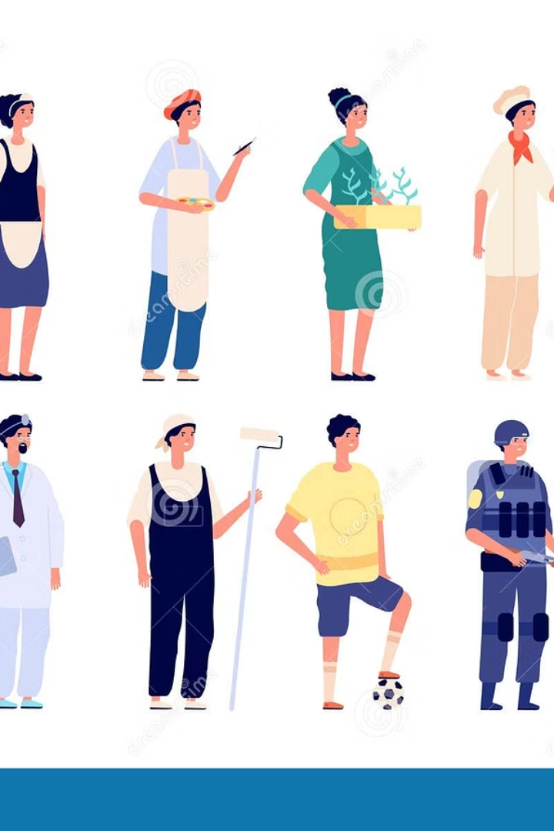
Talking About Your Occupation
Professionals
Students
"I work as a doctor."
"I am a student at [university]."
"I am a teacher."
"My job is software engineer."
"I study [subject] at [school]."
Other Situations
"I'm currently between jobs."
"I'm a stay-at-home parent."

Slide 6
Mentioning Your Origin
Personal History
Specific Location
"I grew up in Surabaya, East Java."
Basic Origin
"I come from Jakarta, Indonesia."
"I am from Indonesia."

Slide 7
Describing Your Hobbies
Sharing hobbies helps connect with others:
Reading
Music
"I enjoy reading books, especially mysteries."
"I like listening to music and playing piano."
Photography
Sports
"I take photos of nature and architecture."
"I play basketball with friends on weekends."
Mention how long you've enjoyed your hobby to start conversations.

Slide 8
Putting It All Together
A complete self-introduction combines all elements smoothly. Here's how to structure your introduction with examples:
Name
"Hi, I'm Maria. It's a pleasure to meet you all today. In professional settings, I go by Maria Lopez, but my friends call me Mari."
Age
"I'm 20 years old. I was born in 2003, so I'm part of Generation Z. In my culture, turning 20 marks an important milestone toward adulthood."
Occupation
"I'm a student at ABC University, currently in my second year of the Computer Science program. I'm specializing in artificial intelligence and machine learning. I also work part-time as a teaching assistant for introductory programming courses."
Origin
"I come from Bandung, which is the capital of West Java province in Indonesia. It's known as the 'Paris of Java' because of its cool climate and beautiful architecture. I grew up in the northern part of the city, near the volcanic highlands."
Hobbies
"I enjoy reading novels, particularly science fiction and mystery genres. In my free time, I also practice photography, focusing on street and landscape shots. On weekends, I volunteer at the local animal shelter and play badminton with friends from university."
Practice combining these elements into a smooth, natural introduction that you can adapt for different situations. Remember to maintain eye contact and speak clearly when introducing yourself.

Slide 9
Roleplay: Practicing Self-Introduction
Now it's time to practice what you've learned through roleplay exercises. Work with a partner and take turns introducing yourselves using the elements we've covered.
Scenario 1: First Day at University
Scenario 2: Job Interview
Scenario 3: International Conference
You're at a job interview. Introduce yourself professionally, highlighting your name, educational background, relevant experience, and what interests you about the position.
Imagine it's your first day in a new class. Introduce yourself to your classmates, mentioning your name, age, field of study, where you're from, and one hobby.
You're attending an international conference. Introduce yourself to other participants, sharing your name, occupation, country of origin, and professional interests.
After each roleplay, give each other feedback on clarity, completeness, and natural delivery. Remember to maintain eye contact and speak with confidence!

Slide 10
Putting It All Together: Sample Dialogue
Scenario: First day in English class
Teacher: Welcome! Let's introduce ourselves. Who would like to start first?
Andi: I'll start. Hello everyone! I'm Andi Wijaya, 20 years old. I'm studying Computer Science at Jambi University. I'm from Bandung, Indonesia. I enjoy photography and volunteering at an animal shelter.
Teacher: Thank you, Andi! Who's next?
Sarah: Hi! I'm Sarah Ayu, 19 years old. I'm studying Business at Batanghari University. I'm from Bangko. I like playing piano and hiking mountains. I'm here to improve my English skills.
Teacher: Very good! Notice how they mentioned their name, age, education, origin, and interests - simple but informative.
Andi: Teacher, should I mention my part-time job in my introduction?
Teacher: Yes, that's relevant information. Would you like to add that?
Andi: Yes. I also work part-time as a teaching assistant for computer classes.
Teacher: Great! Remember to adjust your introduction based on your audience.

